Slide 1


June 2025
Residual Corrective Diffusion Modeling for Km-Scale Atmospheric Downscaling (CorDiff)
TUTORIAL
Manmeet Singh and Naveen Sudharsan
Department of Earth and Planetary Sciences, The University of Texas at Austin

Slide 2




Why We Need Km-Scale Downscaling
Local hazards (e.g., floods, typhoons) need km-resolution
High-resolution data is critical for accurate prediction and management of localized extreme weather events
Global simulations (e.g., ERA5) are too coarse (25 km)
Standard global models lack the resolution needed for local-scale predictions and analysis
High-res physics models are expensive:
• WRF @ 2 km → 928 CPUs, slow & energy-intensive
• Computational and energy costs make widespread deployment impractical
Solution: Learn from existing high-res models using ML downscaling
Machine learning approaches offer computationally efficient alternatives that can learn patterns from existing high-resolution data
Mardani, M., et al. (2025). Communications Earth & Environment, 6(1), p.124

Slide 3
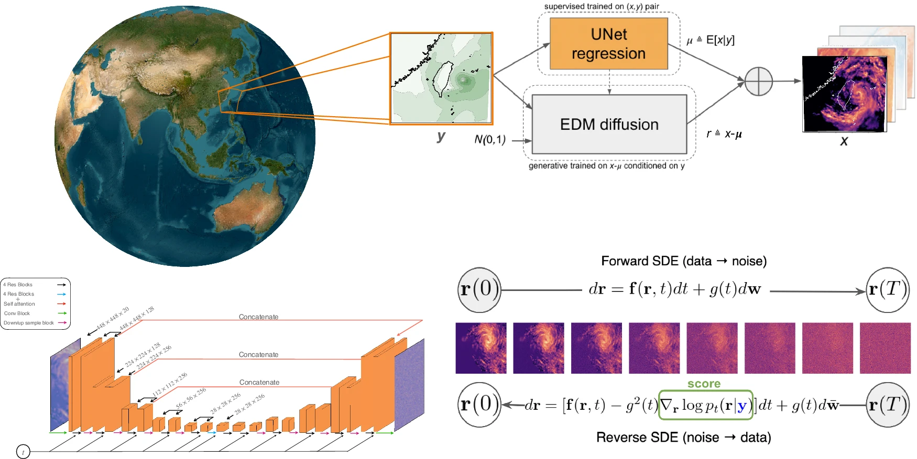

The CorDiff Architecture at a Glance
1
Input: 25 km coarse global data (e.g., ERA5)
Step 1: UNet regression predicts the mean (μ)
2
Deterministic prediction of high-resolution fields
Step 2: Diffusion model generates stochastic residual (r)
3
Captures statistical variations and extreme events
Output: High-res (2 km) weather fields + radar synthesis
4
Final high-resolution output with realistic variability
Inspired by: Reynolds decomposition (mean + fluctuation)
A classical approach in fluid dynamics adapted for ML
Mardani, M., et al. (2025). Communications Earth & Environment, 6(1), p.124

Slide 4

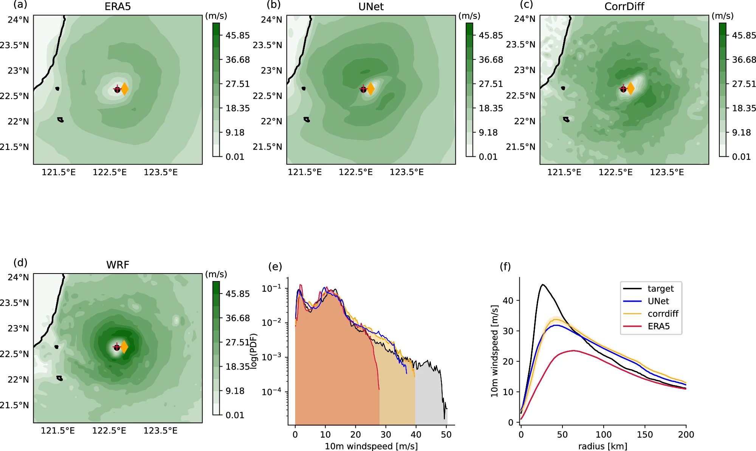



From Mean to Reality
Learning Direct High-Resolution is Challenging
p(x|y)
= hard
Where x is high-resolution data and y is coarse input
The CorDiff Approach: Learn Residuals Instead
p(r = x - μ | y)
= simpler!
Where r is the residual and μ is the mean prediction
Especially helpful for:
Synthesizing new channels (e.g., radar)
Extreme events (e.g., typhoons)
Mardani, M., et al. (2025). Communications Earth & Environment, 6(1), p.124

Slide 5

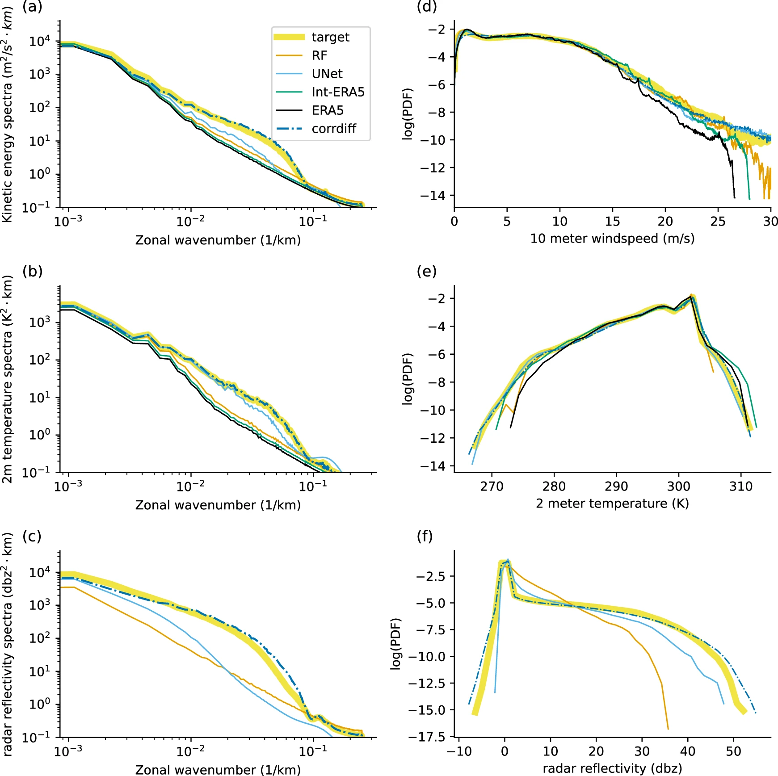






CorDiff Beats Baselines in Realism
Metrics (2021 Test Set)
Best CRPS: CorDiff
Continuous Ranked Probability Score measures probabilistic forecast accuracy
Realistic power spectra: wind, temperature, radar
Accurately captures spatial frequency distributions across variables
Probability distributions → better extreme event tails
Critical for capturing rare but high-impact weather events
Baselines Compared:
Interpolation (ERA5)
Random Forest
UNet regression only
Mardani, M., et al. (2025). Communications Earth & Environment, 6(1), p.124

Slide 6



https://github.com/manmeet3591/cordiff_tutorial
cordiff_model.py
# CorDiff: UNet + EDM Diffusion
class
CorDiffModel
:
def
__init__
(self, config):
self.unet =
UNetRegression
(config)
self.diffusion =
EDMDiffusion
(config)
def
forward
(self, x, y):
# Step 1: UNet predicts mean
mean = self.unet(y)
# Step 2: Diffusion model for residuals
Implementation Highlights
residual = self.diffusion(x - mean, y)
PyTorch implementation with modular architecture
# Final high-res output
return
mean + residual
Pretrained UNet weights available for quick start
Example datasets included for ERA5 downscaling
Detailed documentation and tutorials in repository
Mardani, M., et al. (2025). Communications Earth & Environment, 6(1), p.124

Slide 7
Cordiff = unet + EDM Diffusion

Slide 8
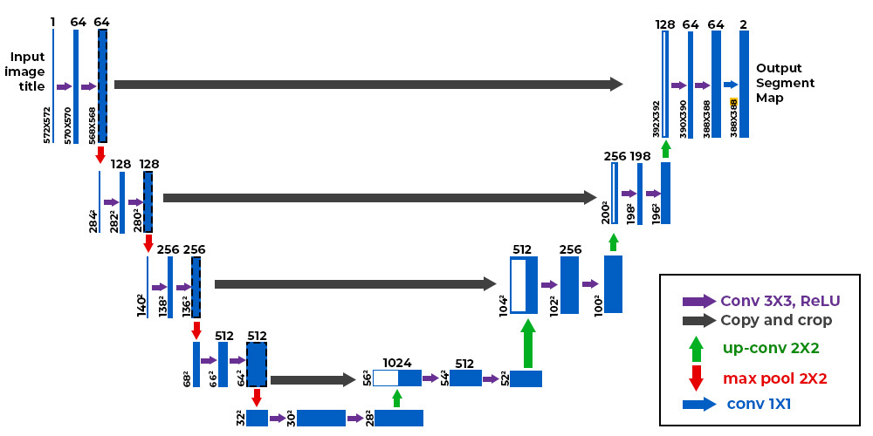
UNET
Ronneberger, O., Fischer, P. and Brox, T., 2015. U-net: Convolutional networks for biomedical image segmentation. In Medical image computing and computer-assisted intervention–MICCAI 2015: 18th international conference, Munich, Germany, October 5-9, 2015, proceedings, part III 18 (pp. 234-241). Springer international publishing

Slide 9
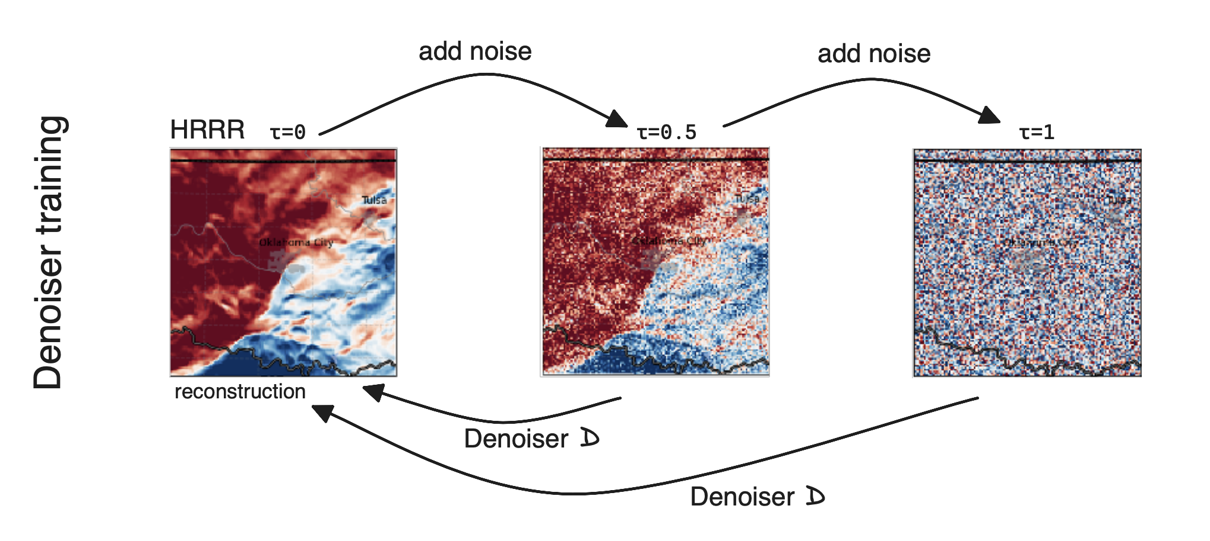
EDM Diffusion
Karras, T., Aittala, M., Aila, T. and Laine, S., 2022. Elucidating the design space of diffusion-based generative models. Advances in neural information processing systems, 35, pp.26565-26577.

Slide 10
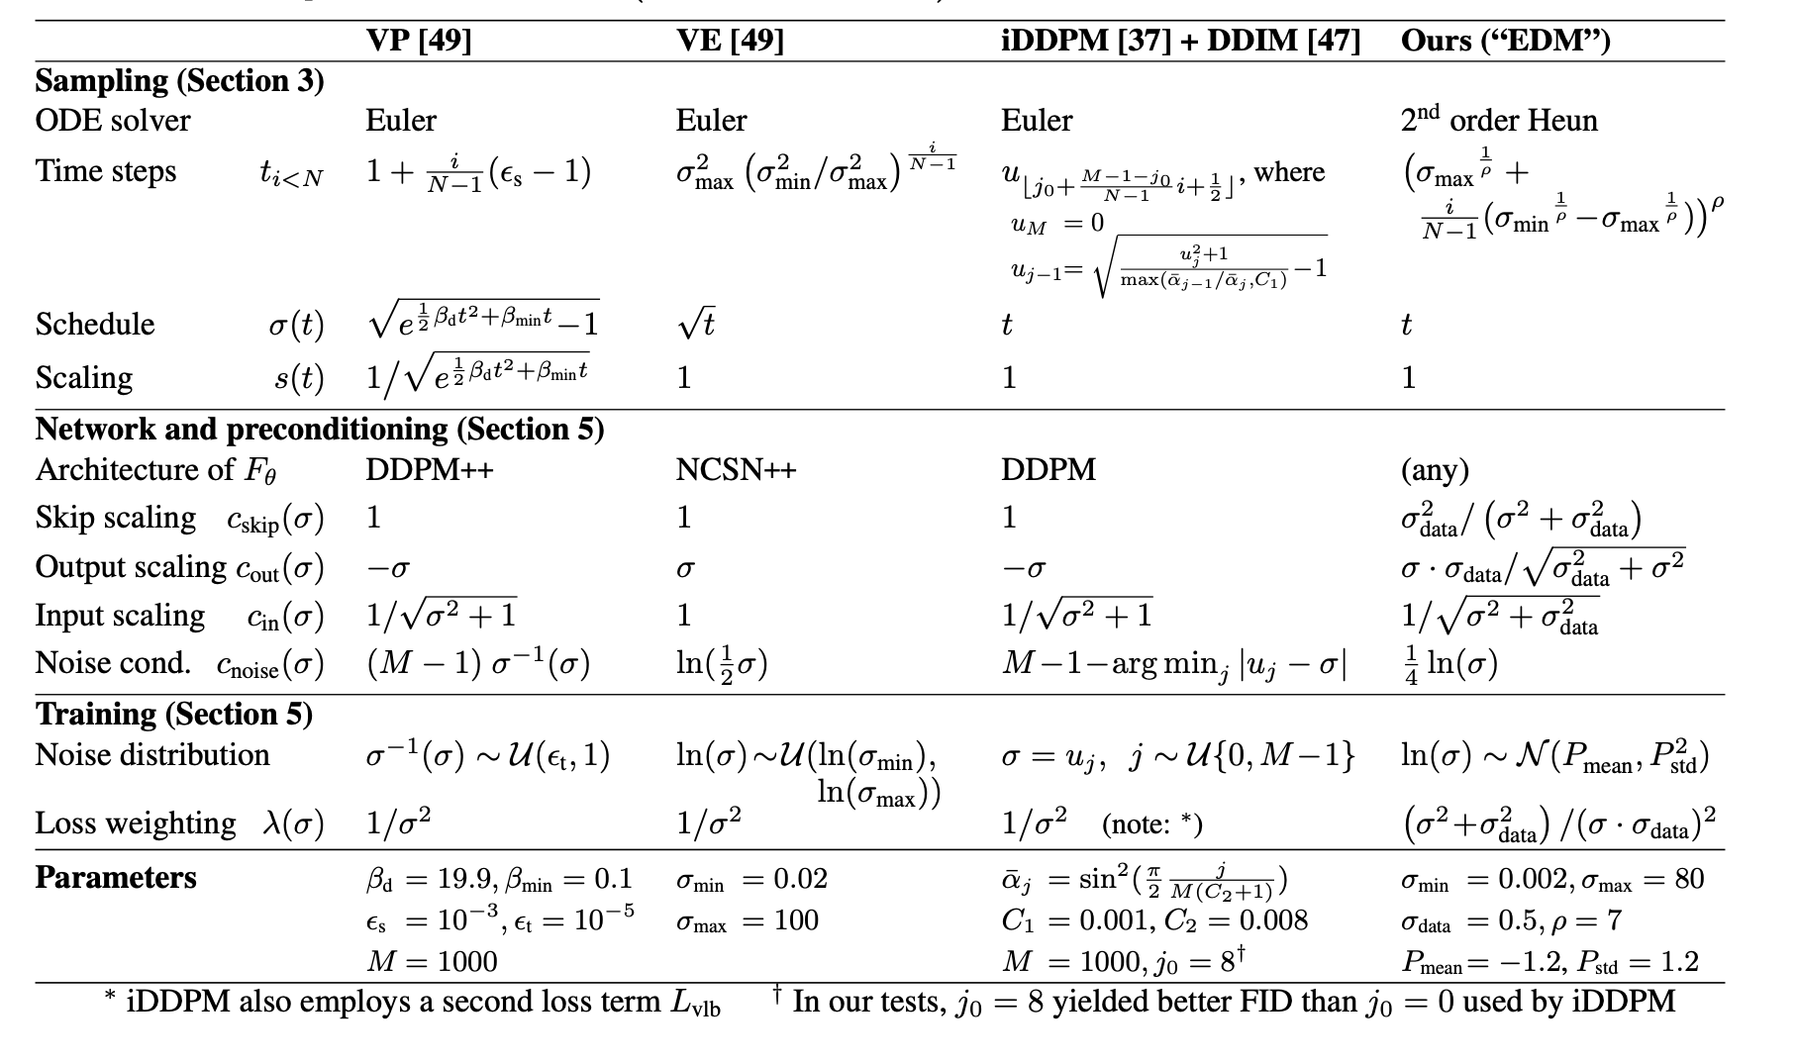
Karras, T., Aittala, M., Aila, T. and Laine, S., 2022. Elucidating the design space of diffusion-based generative models. Advances in neural information processing systems, 35, pp.26565-26577.

